Slide 1
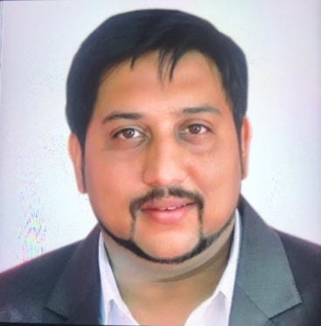
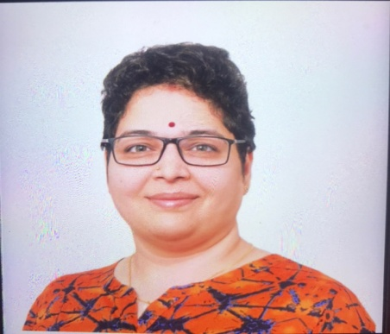
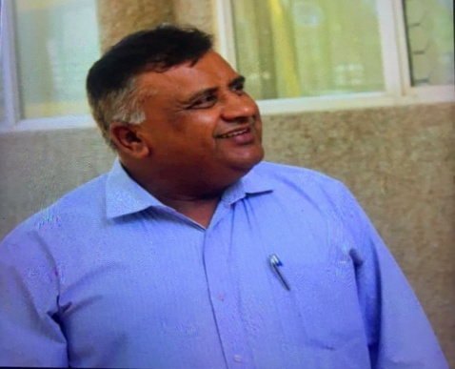
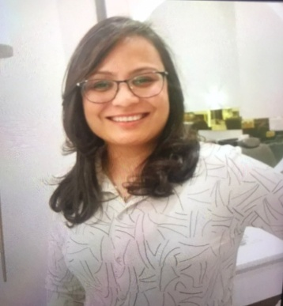
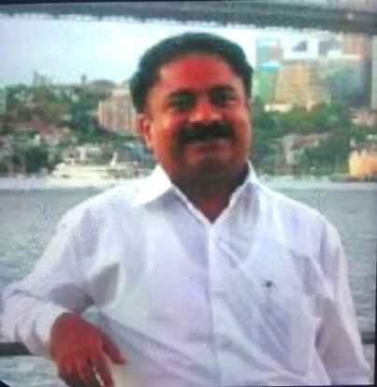
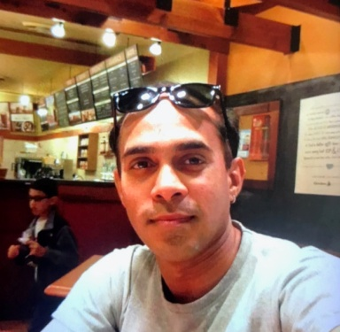
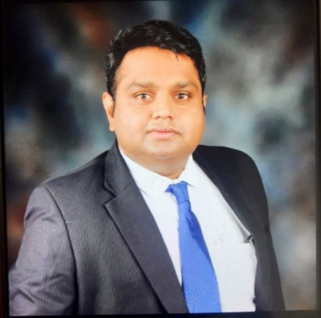
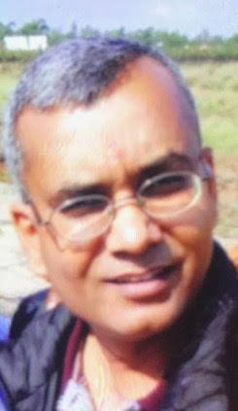
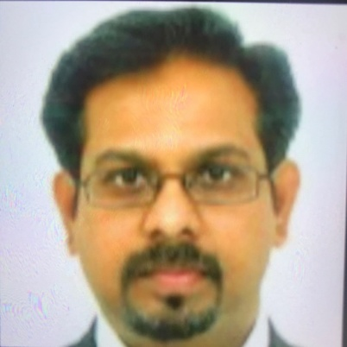
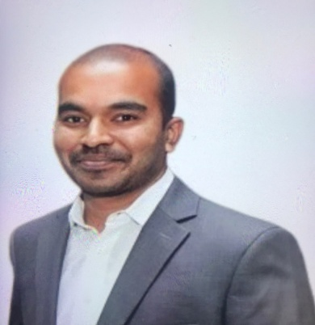
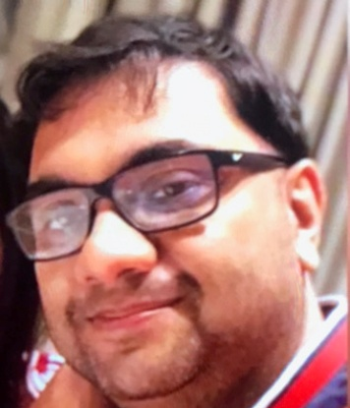
Dr Daniel Singh
Poonam Jain
Manjit Singh
Rajya Lakshmi.T
Dr Ravishankar
GIC VIRTUAL MEET
Ganesh Mahadevan
Sanjay Kumar
Rajesh Kannan
Raja Balusamy
Debashish Banerjee
Raj Nagendra
CORONIZATION OF IT INDUSTRY
ON 1ST MAY 2020
FROM 11.30 AM TO 1.30 PM

